Slide 1
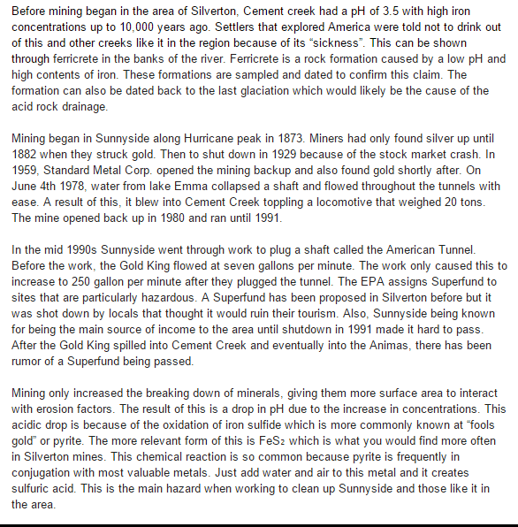
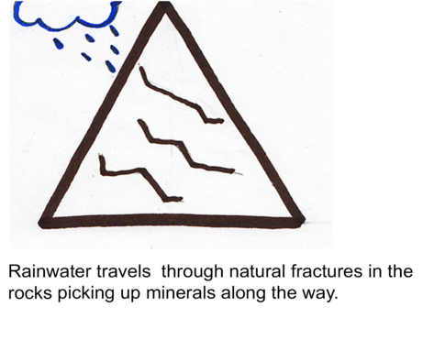
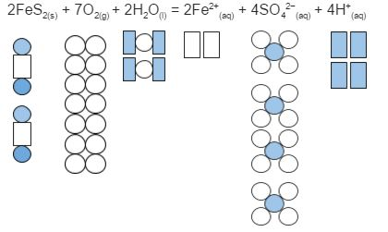
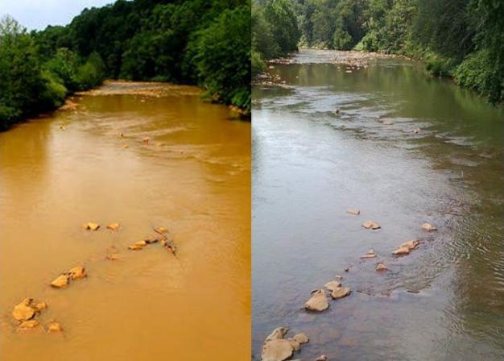
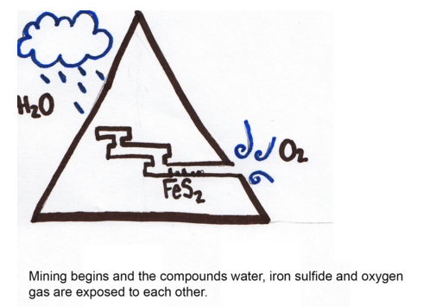
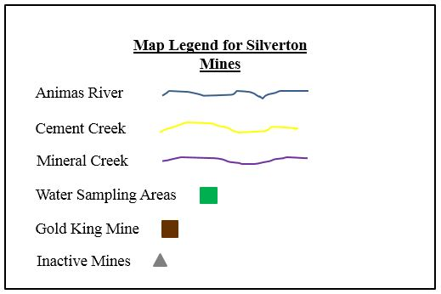
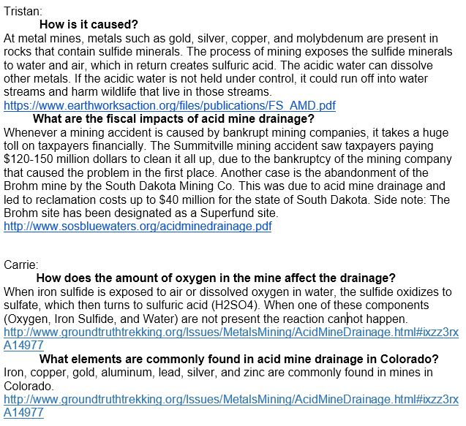
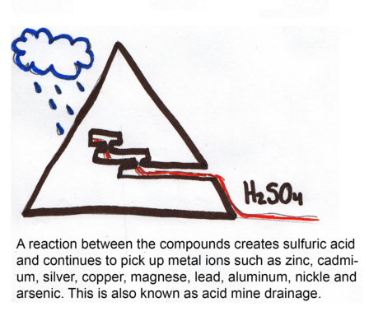
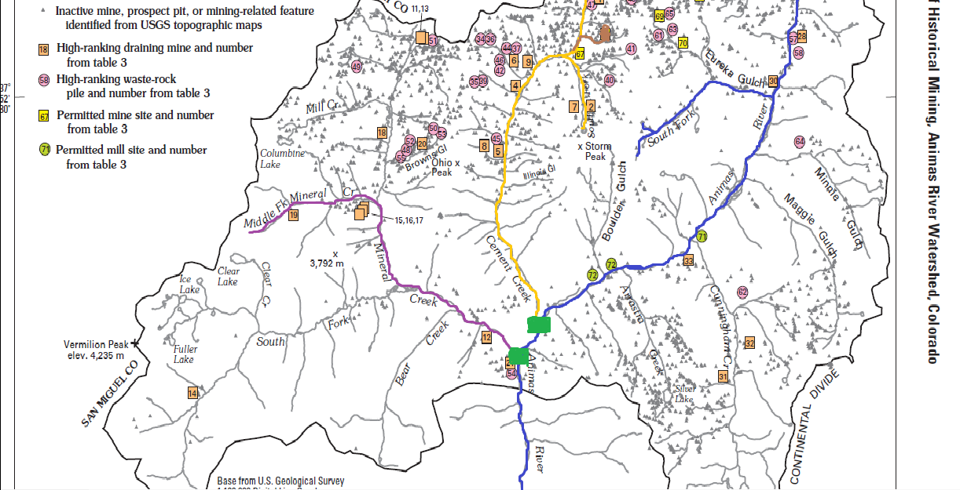
What is Acid Mine Drainage?
Piper Rossi, Carrie Kuhns, Garrett Hagen, Tristan Boyd
History of Mining
Definition of Acid Mine Drainage
About Our Diagram
Acid mine drainage, acid and metalliferous drainage (AMD) refers to the outflow of acidic water from metal mines or coal mines.
Representations of AMD
Maps of the Mines
Questions We Answered
(
(

